Slide 1
Materials Manufacturing (EDPT 601)
Tutorial 2
Metal Casting
(Solidification mechanism and cooling curves)
By: Eng. Sherifa Taher

Slide 2
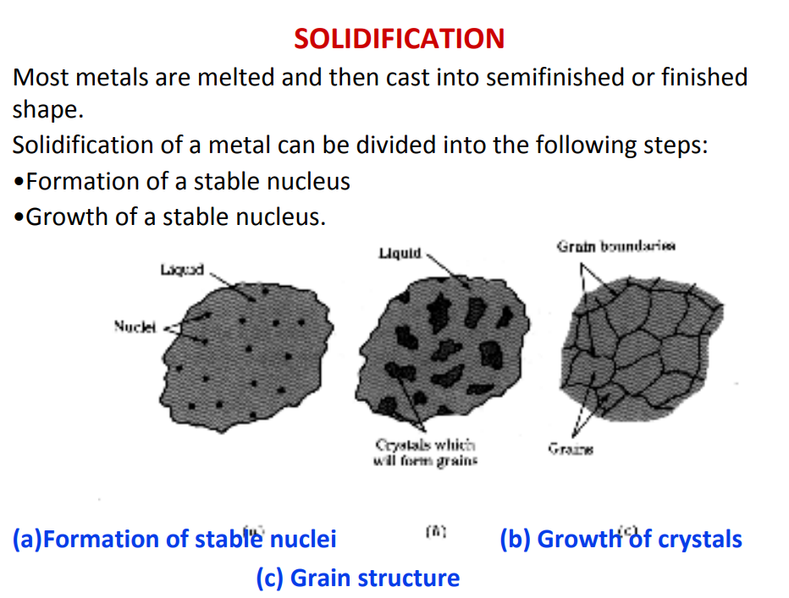
Solidification of metals

Slide 3
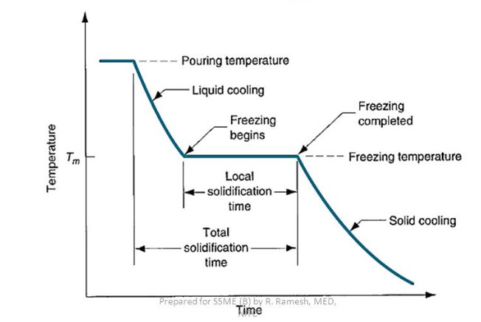
Cooling curve for pure metal or eutectic composition alloy
Eutectic alloy:
Mixture of 2 or more components which usually do not interact to form a new chemical compound but which at certain ratios, result in a system having a single melting point that is lower than either of the components.

Slide 4
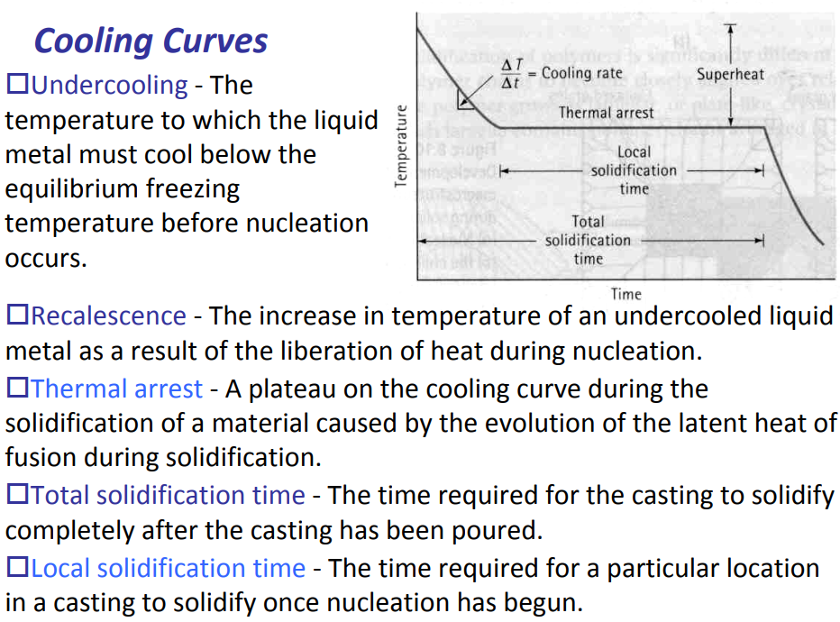

Slide 5
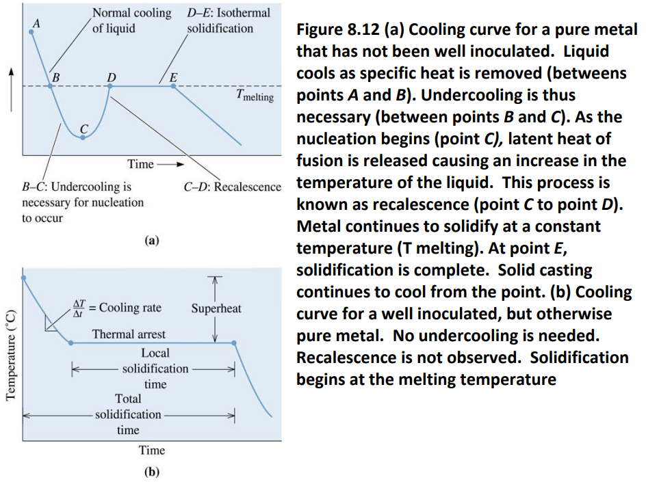
Effect of inoculants on the cooling curve of pure metals

Slide 6
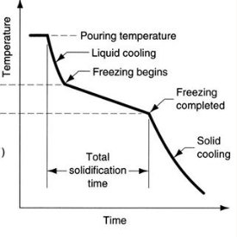
Cooling curve for alloys

Slide 7
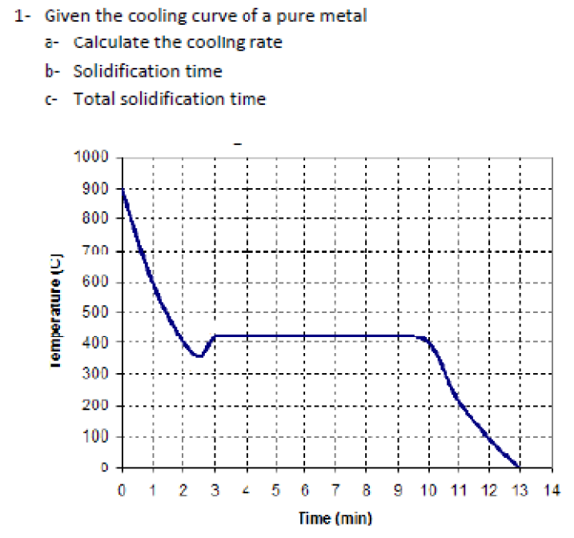
Problems (Assignment 2)
Problem 1

Slide 8
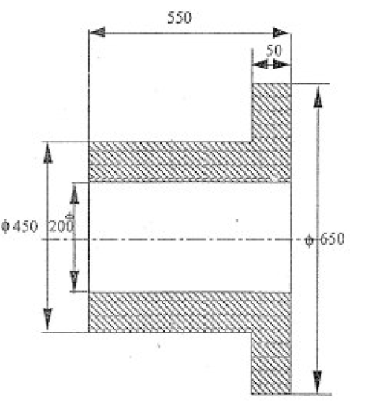
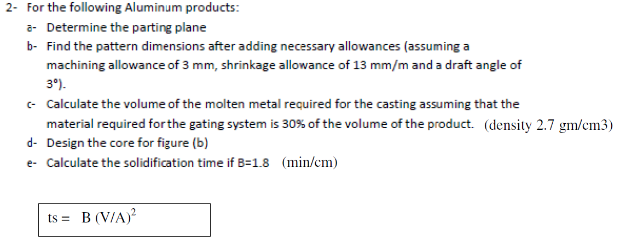
Cont. Assignment 2
Problem 2:

Slide 9
